Slide 1
DEEP LEARNING
By: MANOJ K. JANGRA

Slide 2
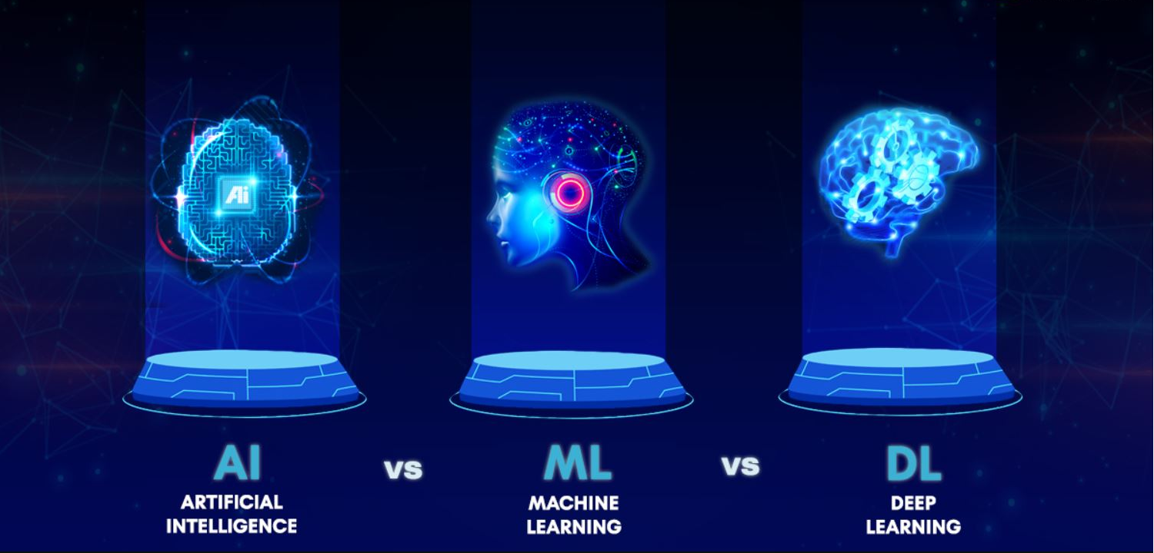

Slide 3
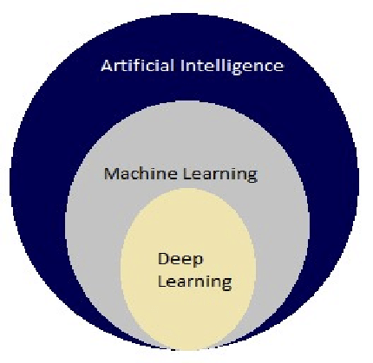
Relationship of AI, Machine Learning & Deep Learning

Slide 4
What is AI???
AI is a branch of Computer Science that is concerned with building smart and intelligent machines.

Slide 5
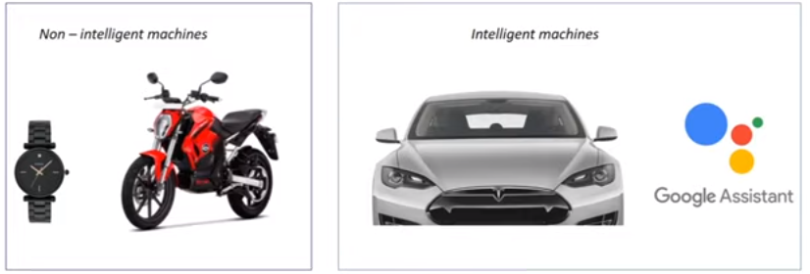
Non-Intelligent V/S Intelligent Machines

Slide 6
Why Intelligent?
They can think,
They can give you answers,
They can do new things &
They cam make their own decisions

Slide 7
What is Machine Learning?
Machine Learning is technique to implement Artificial Intelligence that can learn from the data by themselves, without being explicitly programmed.

Slide 8

Use Case:
Classification of Dog and Cat Image

Slide 9
What is Deep Learning?
Deep learning is a sub-field of Machine Learning, that uses a special type of algorithms, called as Artificial Neural Networks to learn from the data.

Slide 10
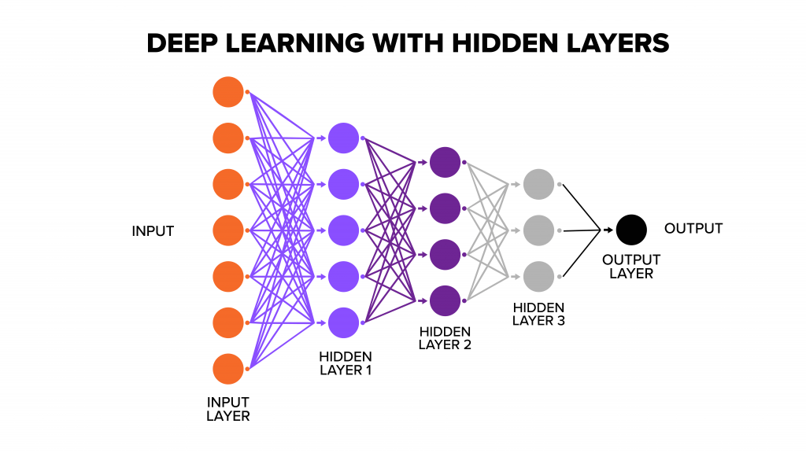

Slide 11
What is Machine Learning?
Machine Learning is technique to implement Artificial Intelligence that can learn from the data by themselves, without being explicitly programmed.

Slide 12
Use Case:
Classification of Dog and Cat Image

Slide 13
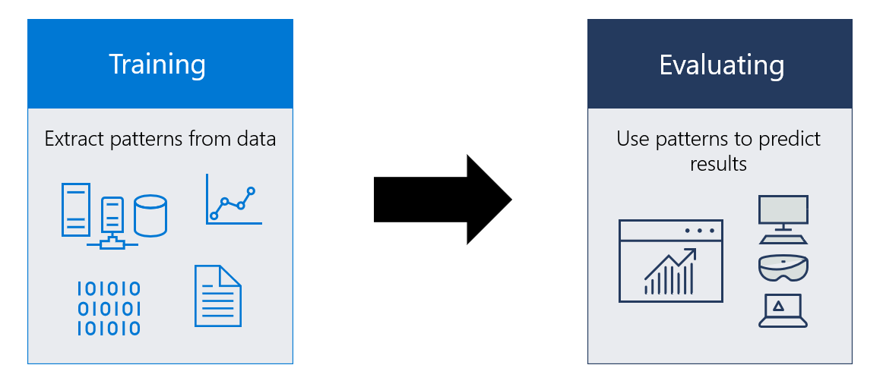
How Machine Learning Works?

Slide 14
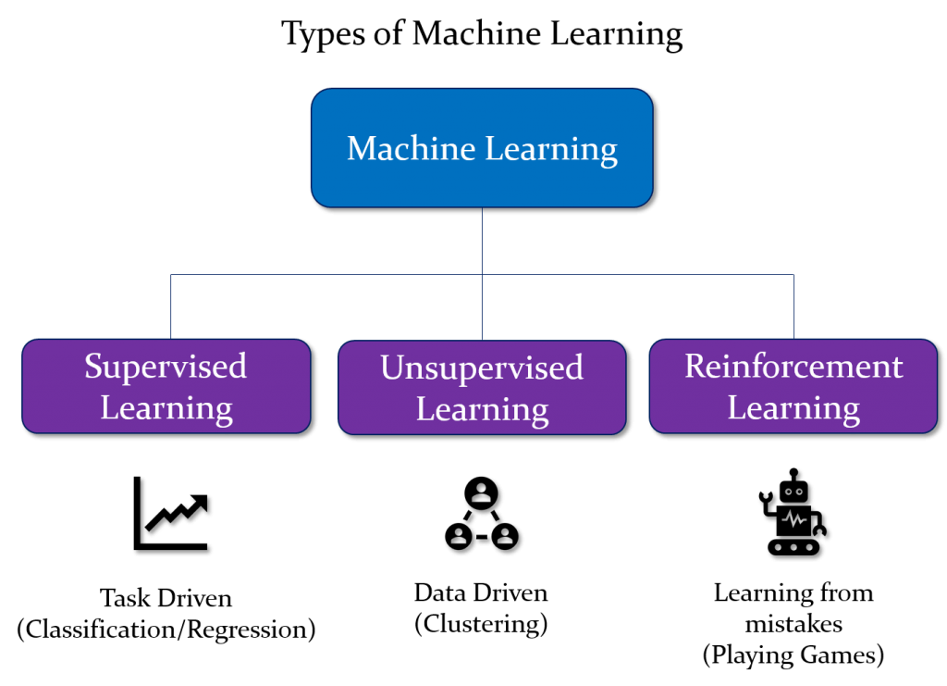

Slide 15
What is Supervised Machine Learning?
In supervised learning, the Machine Learning Algorithm learns from the labeled data.

Slide 16
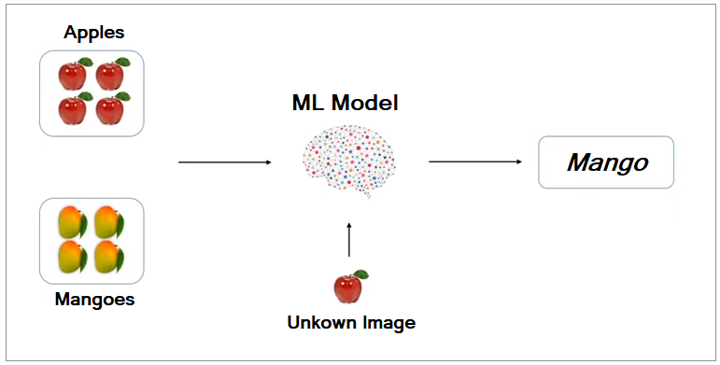
What is Labeled Data?

Slide 17
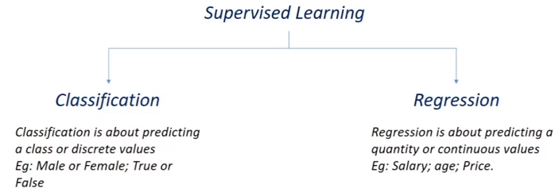
Types of Supervised Learning

Slide 18
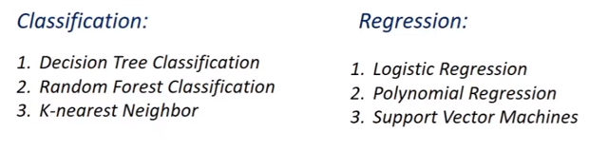
Examples of Supervised Algorithms

Slide 19
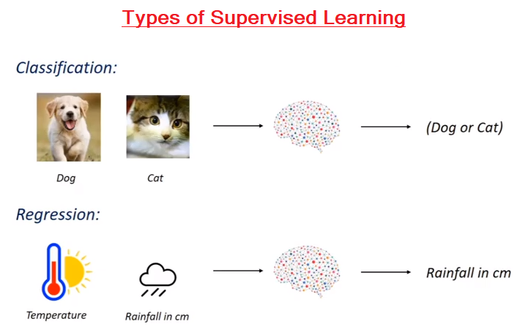

Slide 20
What is Un-supervised Machine Learning?
In Un-supervised learning, the Machine Learning Algorithm learns from the unlabeled data.

Slide 21
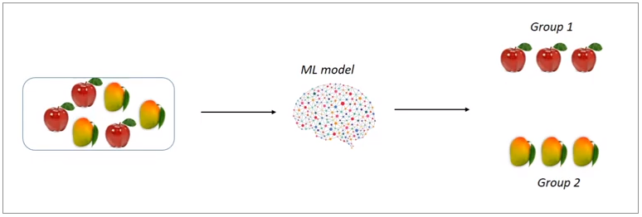
What is Un-supervised Learning?

Slide 22
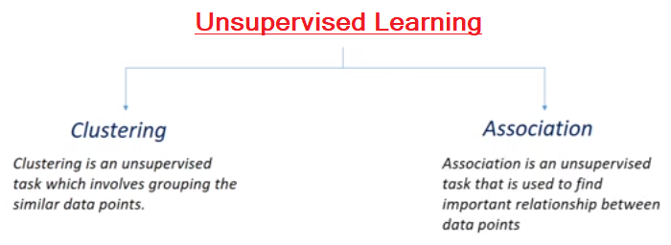
Types of Unsupervised Learning

Slide 23
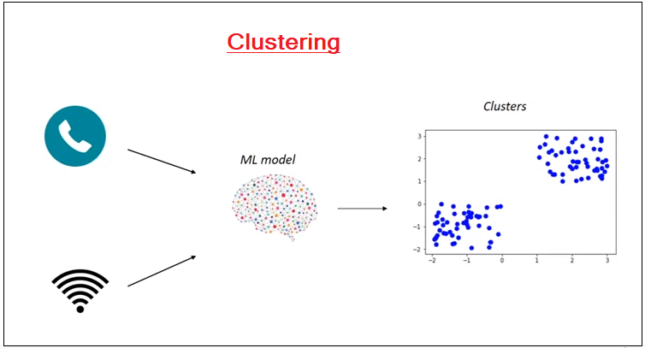

Slide 24
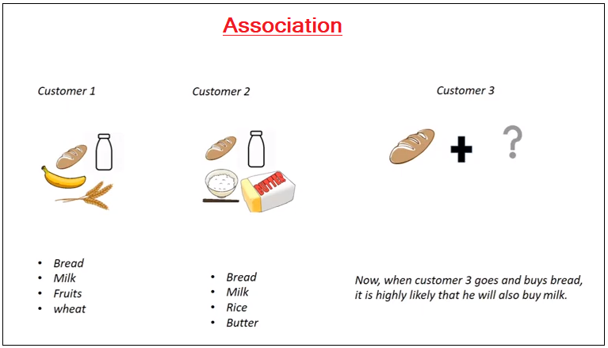

Slide 25
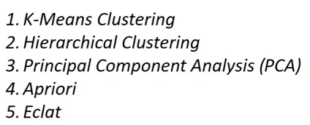
Examples of Unsupervised Learning

Slide 26
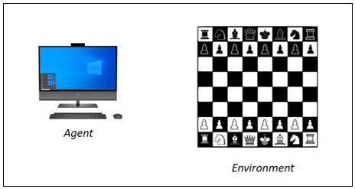
What is Reinforcement Learning?
Reinforcement learning is an area of machine Learning concerned with how intelligent agents take actions in an environment to take action.
Environment
Agent
Action
Reward

Slide 27
What is Deep Learning?
Deep Learning is a sub-field of Machine Learning that uses Artificial Neural Network to learn from data.

Slide 28
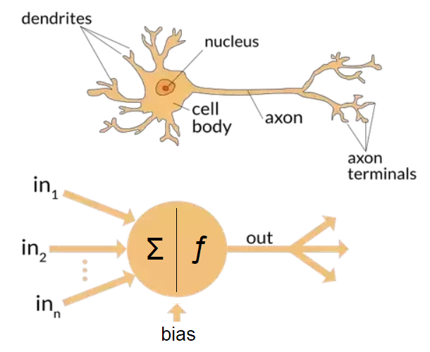

Slide 29
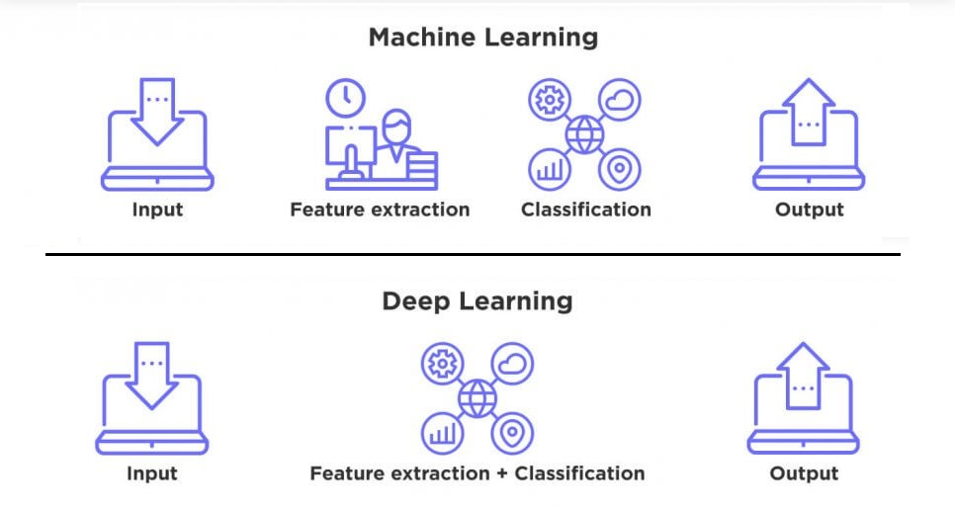
Deep Learning V/S Machine Learning

Slide 30
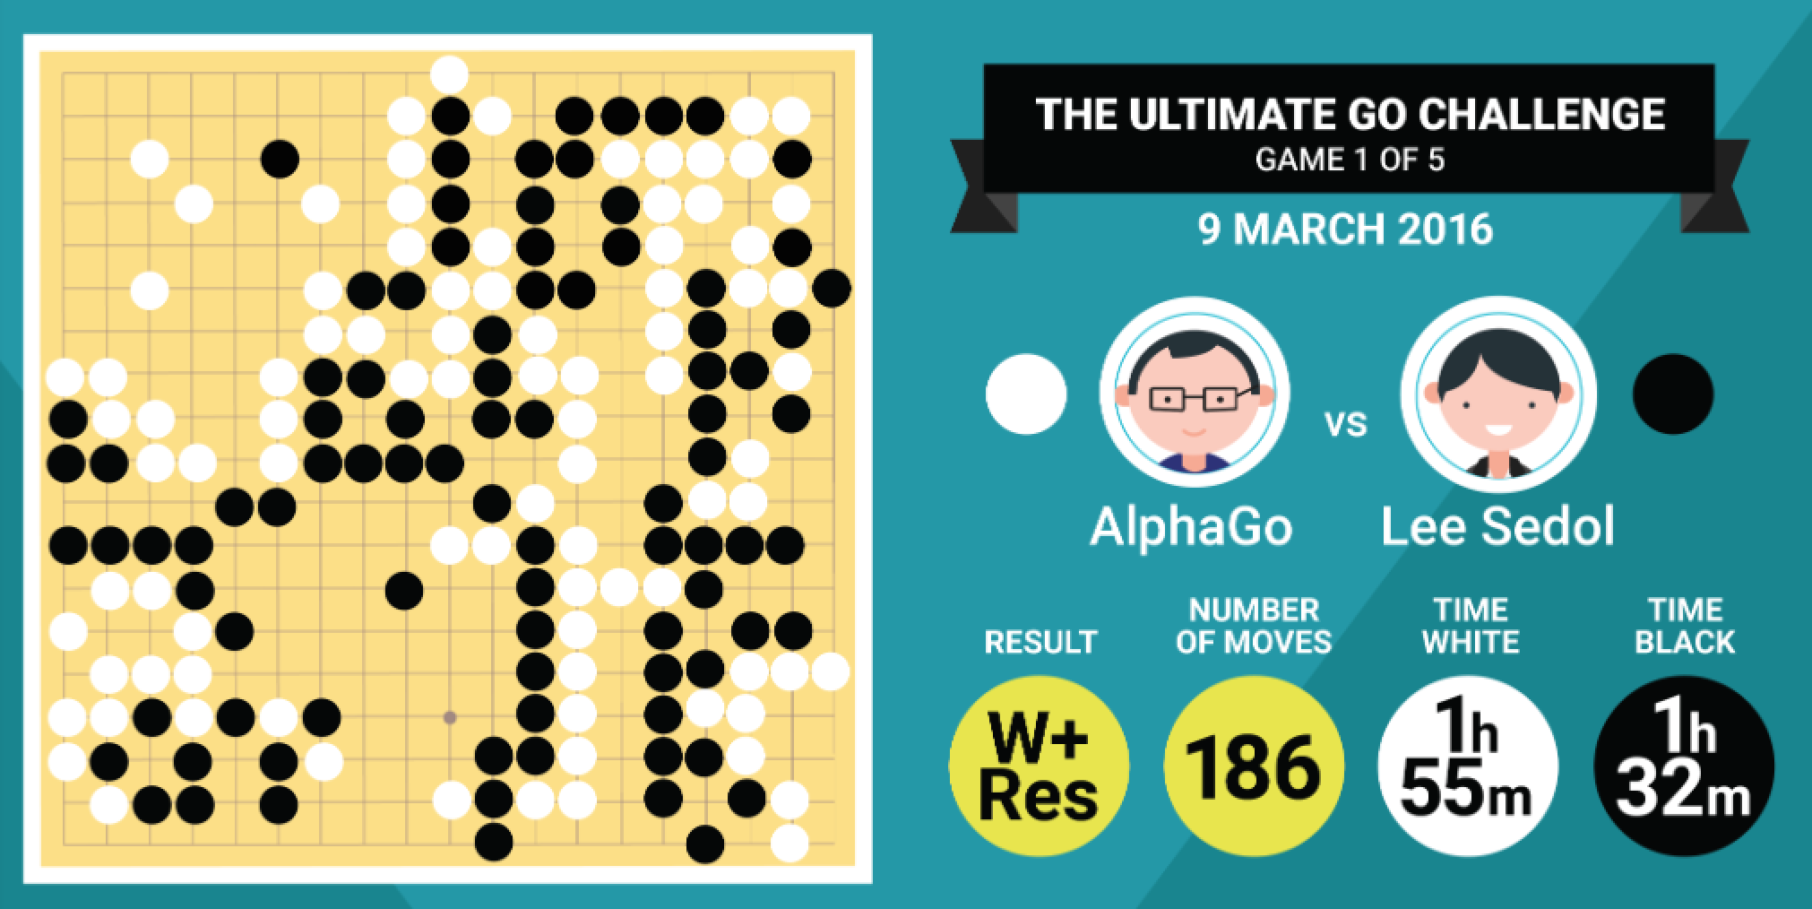
Deep Mind V/S Lee Sedol

Slide 31
AlphaGo versus Lee Sedol
AlphaGo versus Lee Sedol, also known as the Google DeepMind Challenge Match, was a five-game Go match between top Go player Lee Sedol and AlphaGo, a computer Go program developed by Google DeepMind, played in Seoul, South Korea between 9 and 15 March 2016. AlphaGo won all but the fourth game;^{[1]} all games were won by resignation.^{[2]} The match has been compared with the historic chess match between Deep Blue and Garry Kasparov in 1997.
The winner of the match was slated to win $1 million. Since AlphaGo won, Google DeepMind stated that the prize will be donated to charities, including UNICEF, and Go organisations.^{[3]} Lee received $170,000 ($150,000 for participating in the five games and an additional $20,000 for winning one game).^{[4]}

Slide 32
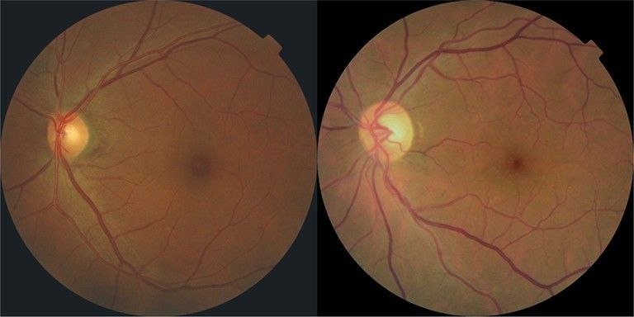
Diabetic Retinopathy

